Slide 1
Artificial Intelligence in Agriculture: Cultivating the Future of Farming
Created By Nishant

Slide 2
Why AI? The Challenges Facing Modern Agriculture
Global population projected to reach 9.7 billion by 2050, increasing food demand.
Climate change leading to unpredictable weather and water scarcity.
Rising operational costs and labor shortages in the farming sector.
Need for sustainable practices to reduce environmental impact.
Pressure to maximize crop yield and ensure food quality.

Slide 3
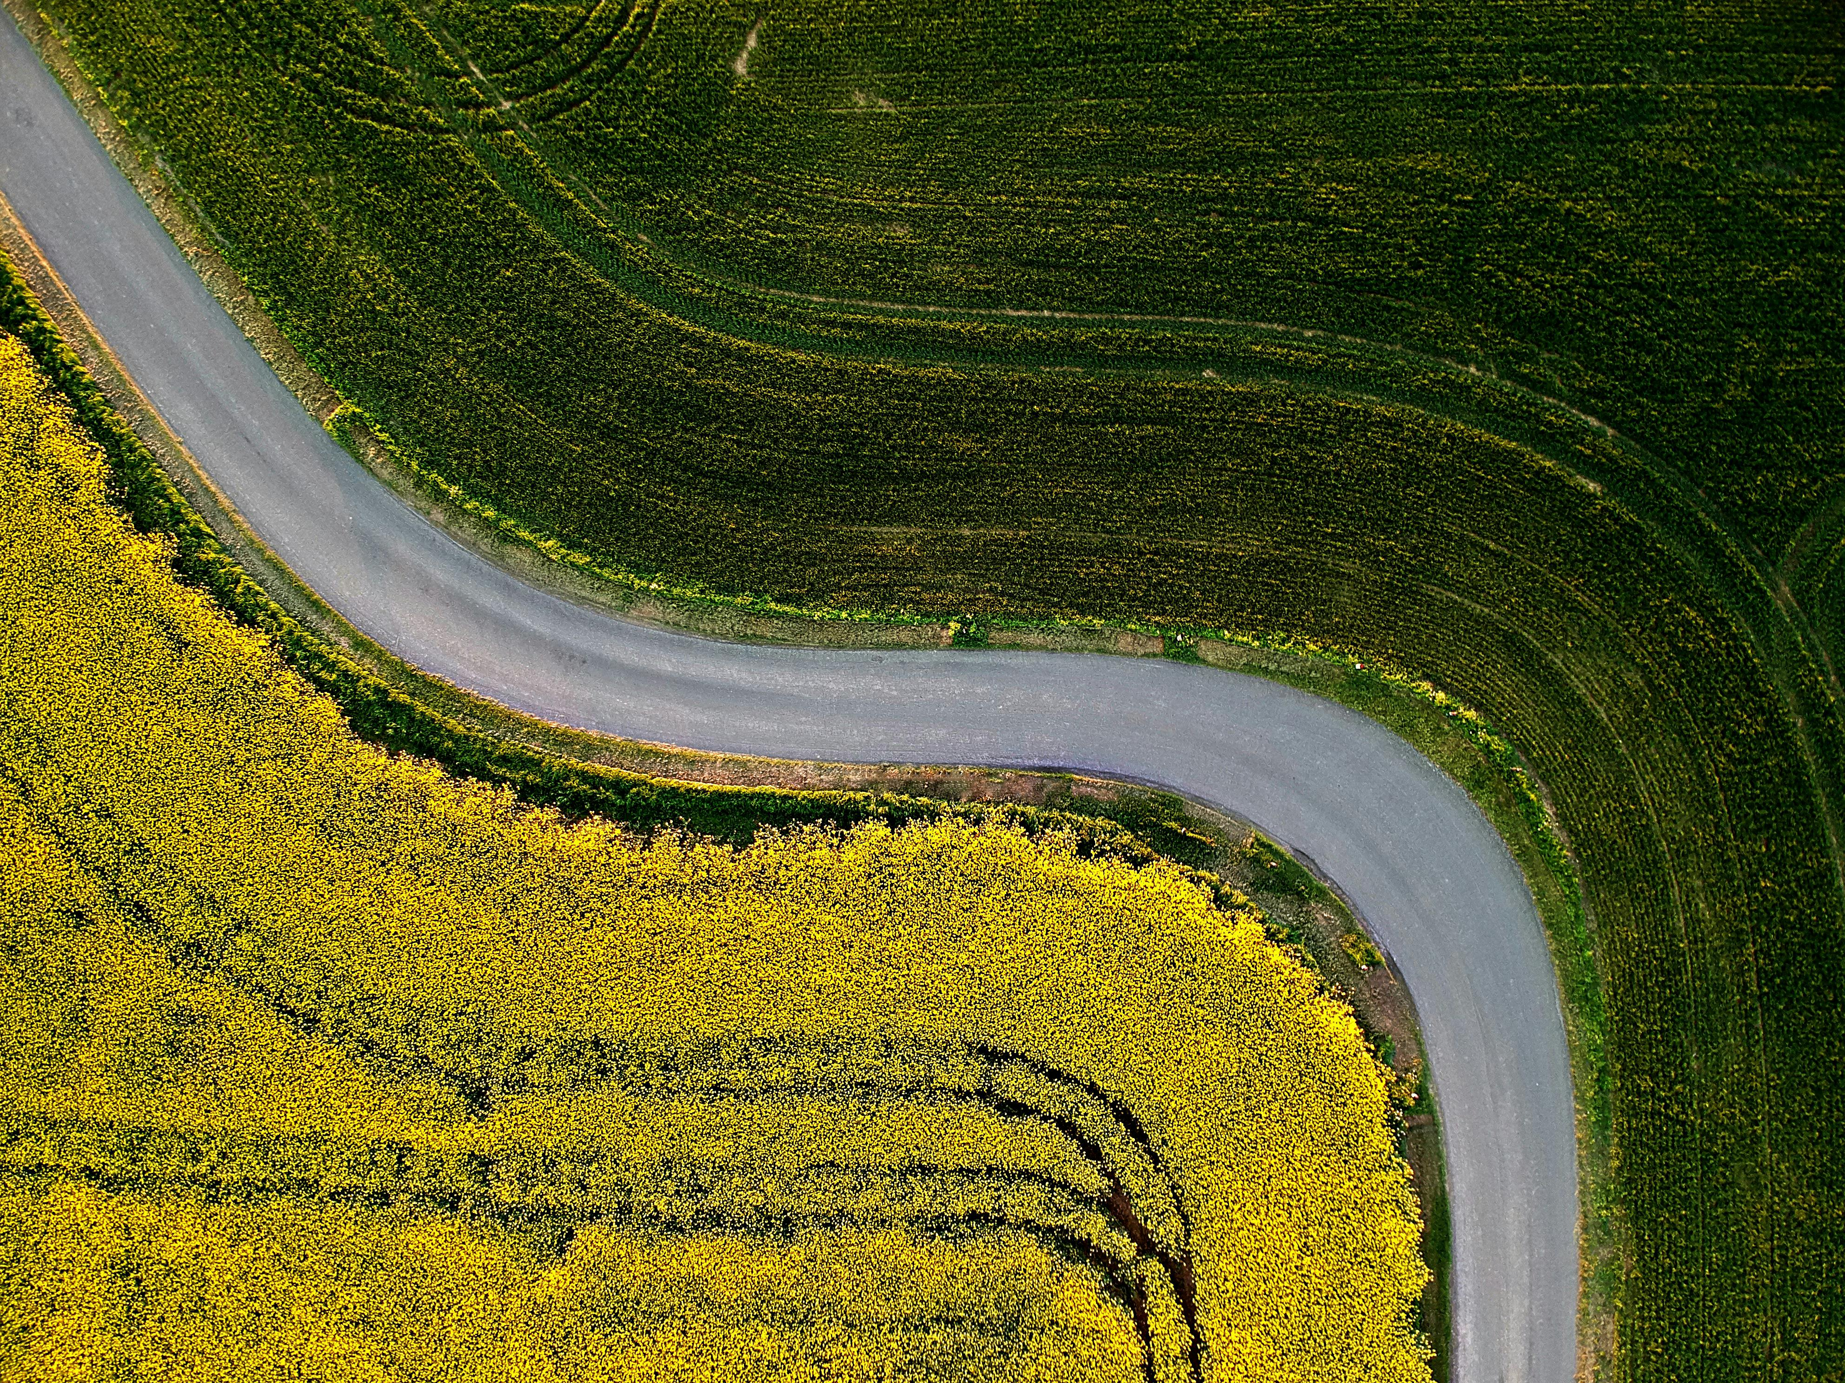
Smart Farming in Action: Precision Agriculture & Drones
Precision Farming: Using AI with IoT sensors and GPS to precisely manage farms.
- AI algorithms analyze data for targeted application of water, fertilizer, and pesticides, reducing waste.
Agricultural Drones: Providing a bird's-eye view for intelligent farm management.
- AI-powered image analysis for crop health monitoring (NDVI).
- Automated and targeted spraying, planting, and irrigation.

Slide 4
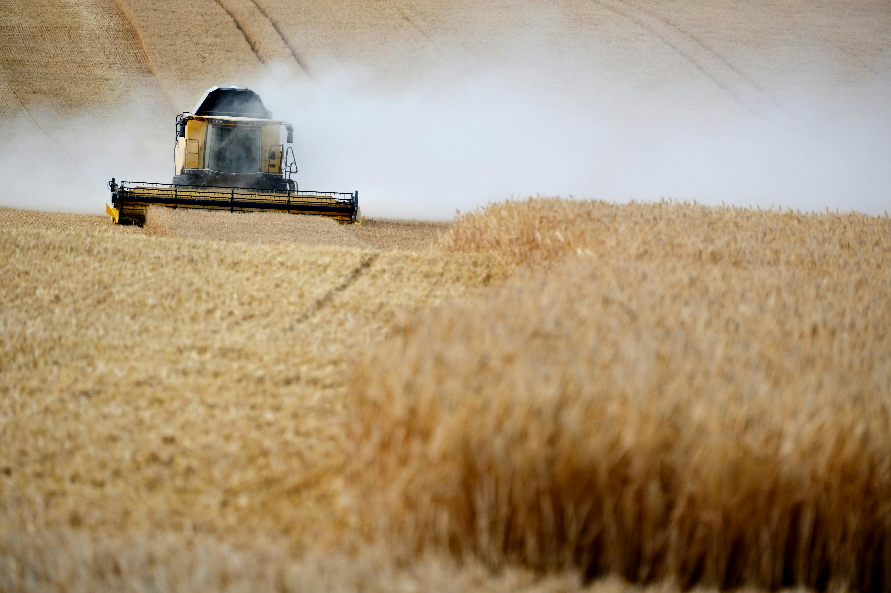
AI-Powered Insights: Predictive Analytics & Robotics
Predictive Analytics: AI models that forecast future events.
- Predicting crop yields based on historical data and weather patterns.
- Early forecasting of pest and disease outbreaks for proactive management.
- Optimizing harvest schedules for peak quality and market value.
Agricultural Robots (Agribots): Automating repetitive and labor-intensive tasks.
- Autonomous tractors for plowing and planting.
- Robotic systems for precise weeding and harvesting.

Slide 5
Reaping the Rewards: The Impact of AI on Farming
Increased Efficiency & Productivity: Achieving higher crop yields with fewer resources.
Cost Reduction: Optimizing the use of water, fertilizer, pesticides, and labor.
Enhanced Sustainability: Minimizing environmental footprint through data-driven precision.
Data-Driven Decisions: Empowering farmers with actionable insights instead of guesswork.
Improved Crop Quality: Early detection of diseases and nutrient deficiencies leads to healthier produce.

Slide 6
The Road Ahead: Challenges and Future Outlook
Current Challenges:
- High initial cost of technology and implementation.
- Need for technical expertise and training for farmers.
- Data privacy and security concerns.
- Limited internet connectivity in many rural areas.
Future Trends:
- Hyper-automation leading to fully autonomous farms.
- AI integration with blockchain for supply chain transparency.
- Advanced AI for soil health analysis and management.

Slide 7
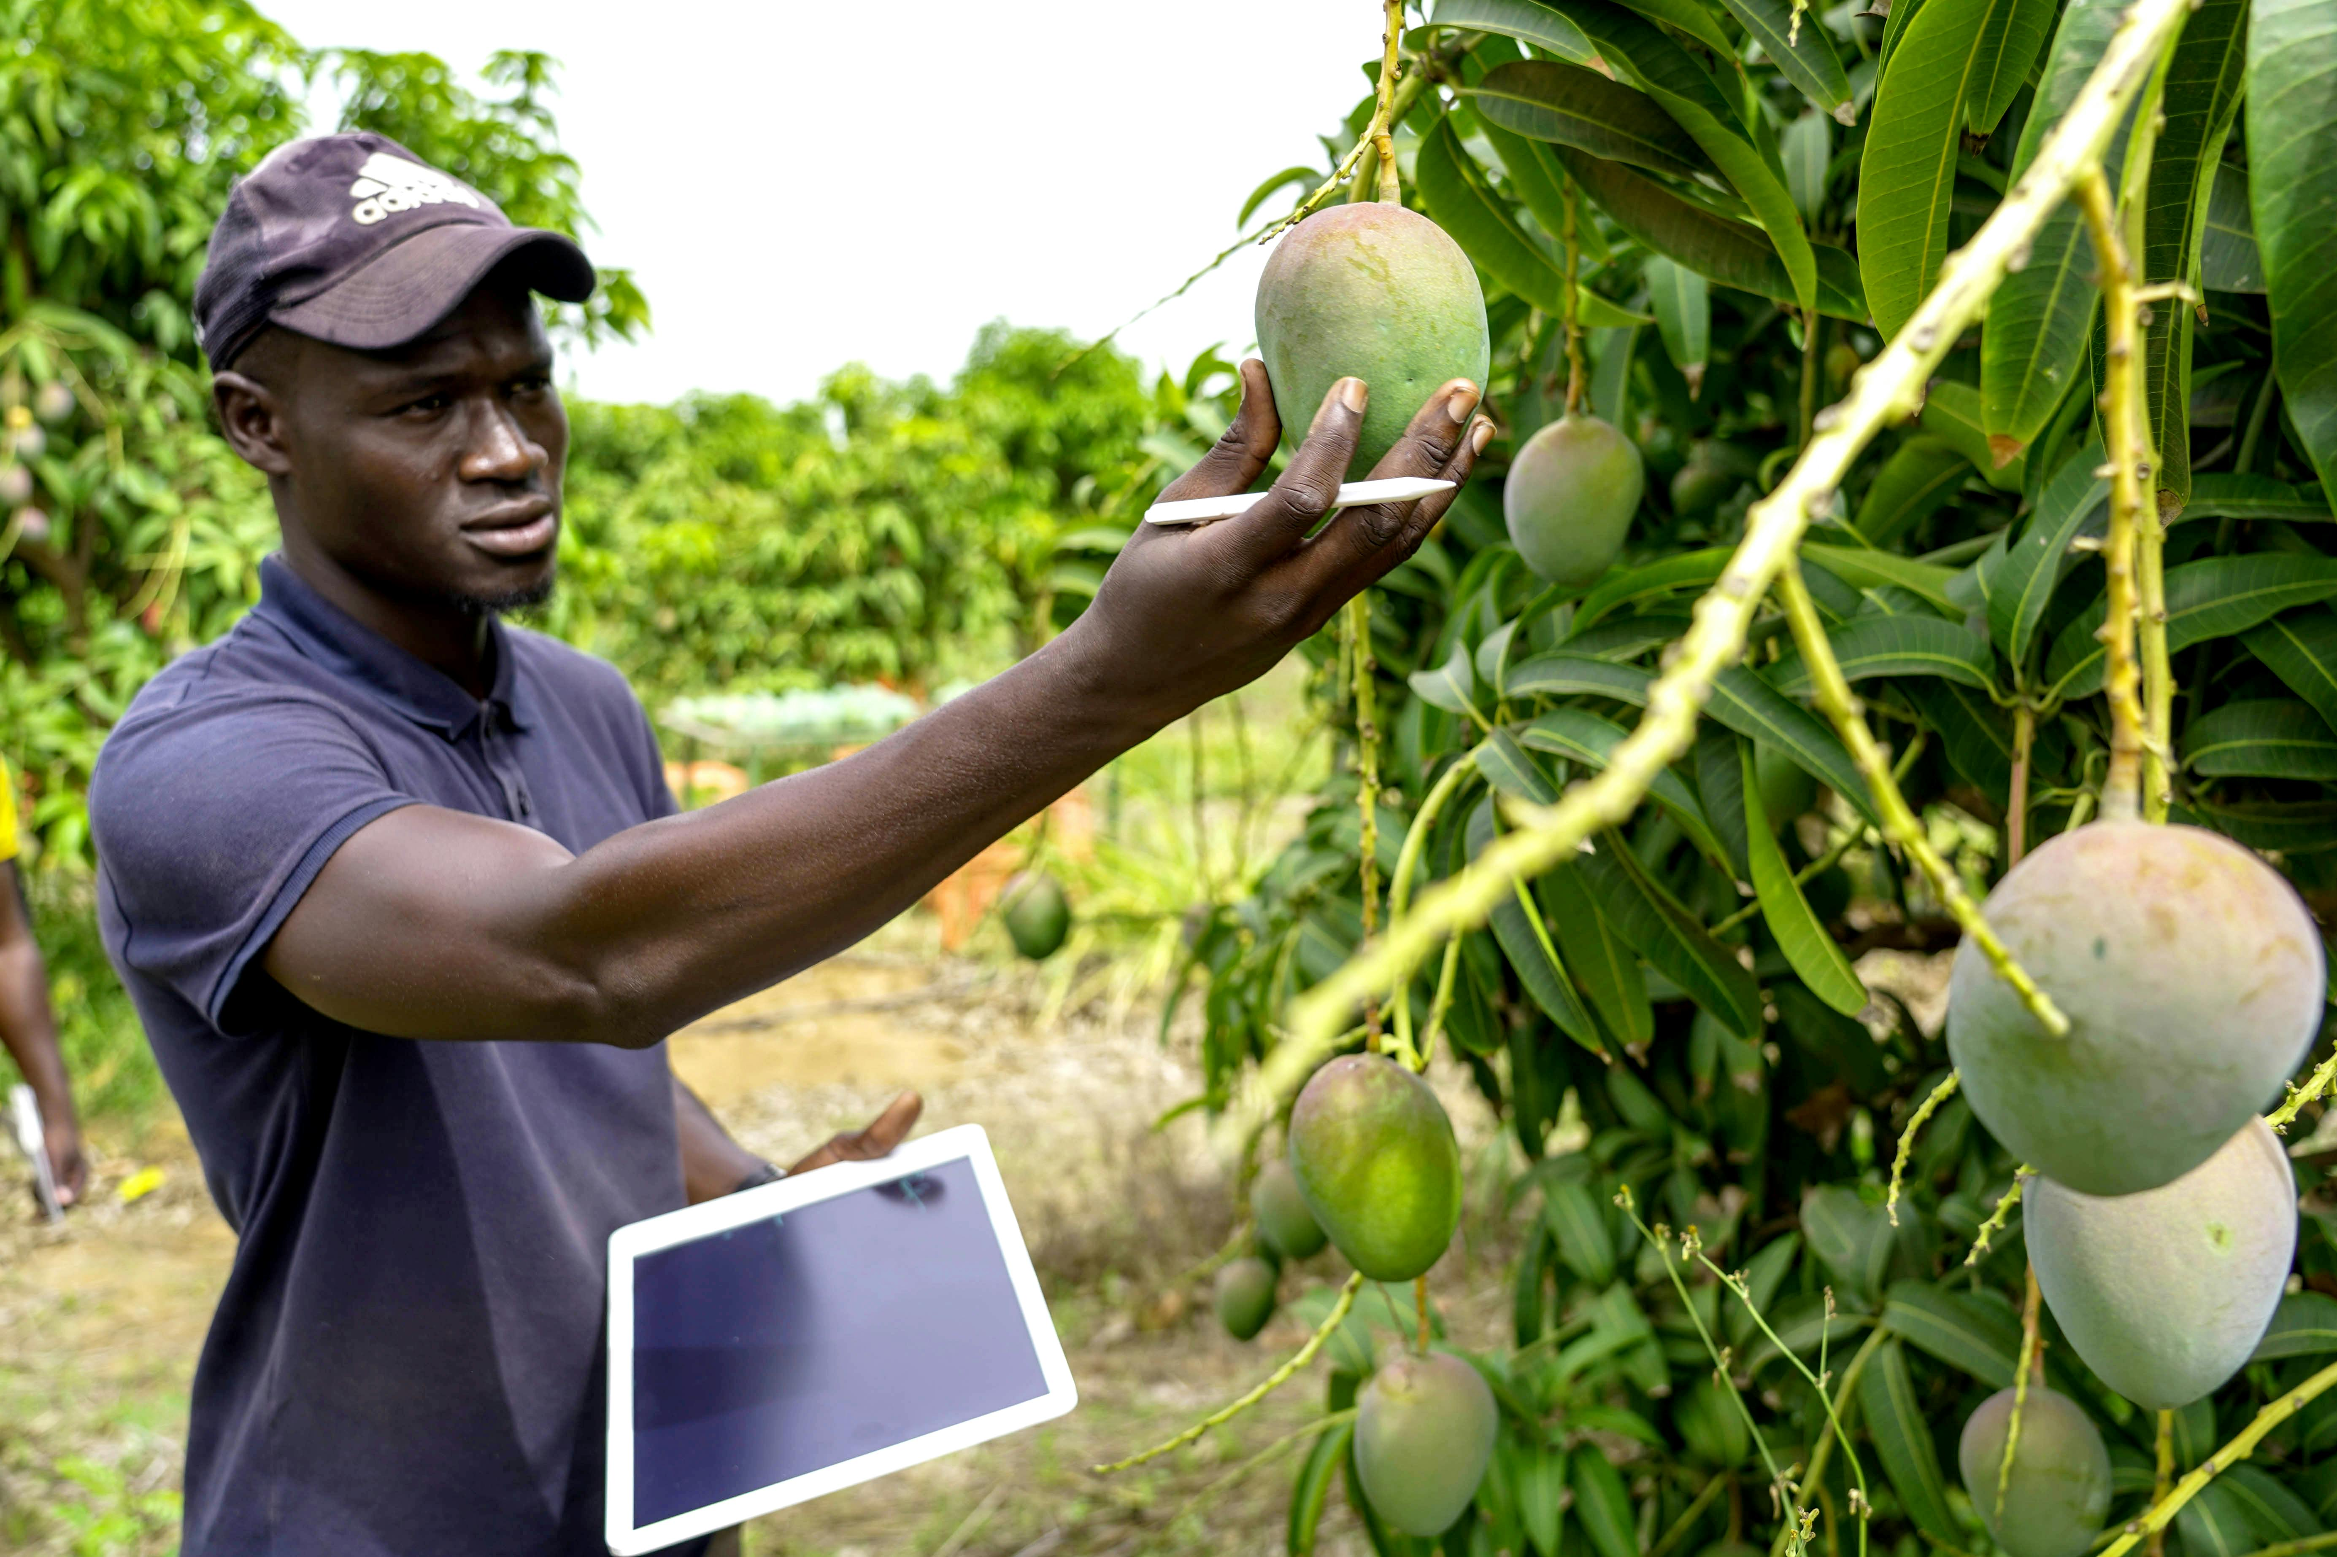
Sowing the Seeds of a Smarter Future
AI is not replacing farmers; it's empowering them with powerful new tools.
Adopting these technologies is crucial for building a sustainable and resilient global food system.
AI in agriculture is key to feeding the future generation efficiently and responsibly.
Thank You & Q/A

